Slide 1

Team Name : Hex
Nodal Center : Institute of Engineering and Technology (IET)
College Name : K.Ramakrishnan College of Engineering,Trichy

Slide 2

Problem statement
Tracking and monitoring of inmates inside the prison

Slide 3
Solution
Face id and unique id number of the inmates is stored.
Cameras are fixed at the ward and the inmates face is recognised.
A Unique id number of the inmate is sent to the destination point.
Cameras are fixed at the destination point.
Face recognition of the inmates is done at the destination point.
Both the recognised face id number and the unique id number of the inmates is compared.
If True the inmate gets the access to the services.

Slide 4
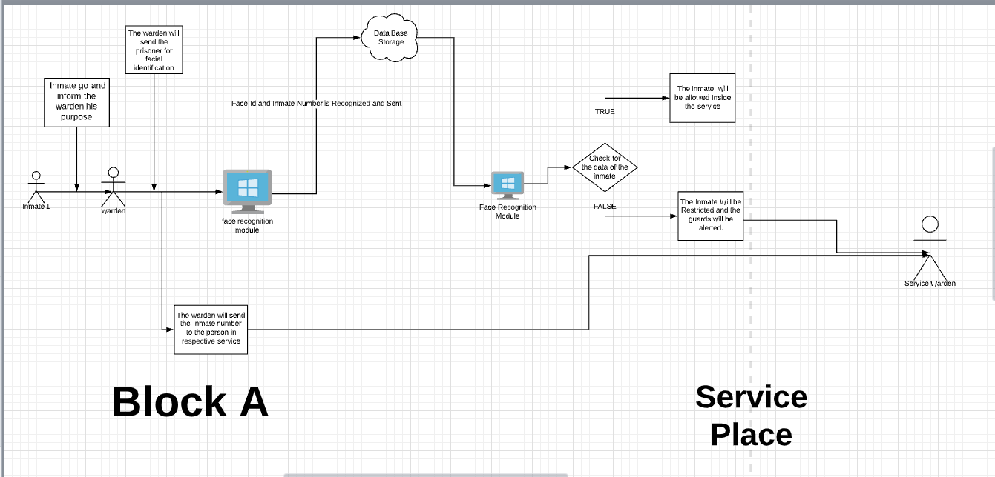

Slide 5
DETECTING THE CORRECT PERSON
The name of the inmate along with the current time stamp will be stored.
It is then compared with the unique id number of the inmate which is given by the warden at the ward.
If both the id matches then the person is allowed in.

Slide 6
Information is Transferred
After the face is recognized , the information is transferred to the database .
From the database, the information of recognized face is transferred to respective service center .
In the service center , the face that has been recognized from the respective block will only be allowed inside the respective service center .

Slide 7
Necessities Needed From Our Side
Guards should be present in every service center.
Led White lights has to be fixed inside the prison , so that at night time it could be useful for identifying the Inmates.
Night visionary camera can be used to detect the face at night time.

Slide 8
Limitations
We are using single database system.So when too much of data is stored , network problem will take place.
During night time, the probability to recognize the face correctly is reduced .

